Slide 1
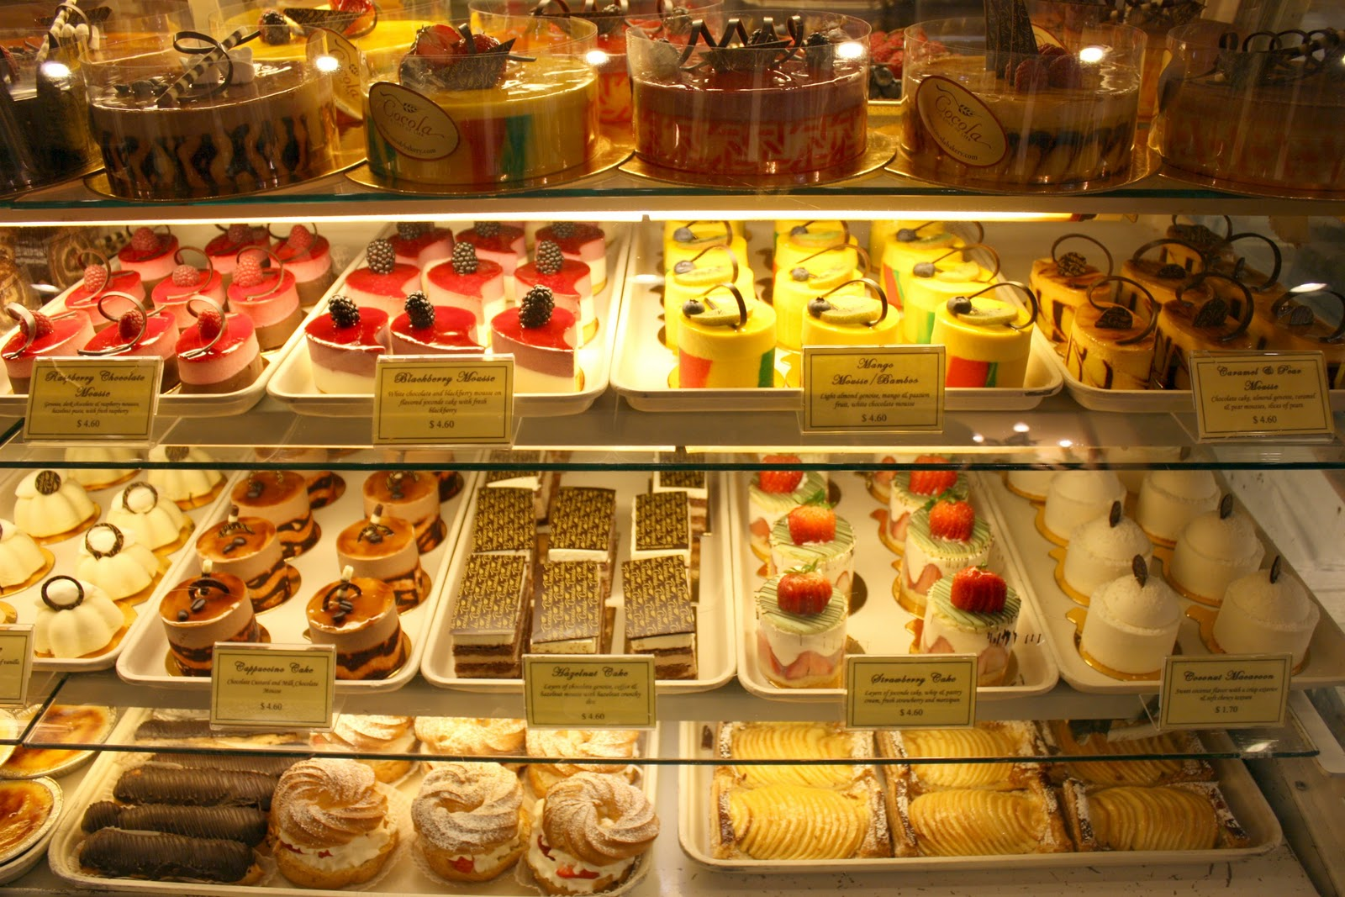
Best Toronto Neighborhood to Open a Bakery (Or Other Dessert-type Venue)
Dana Andrews

Slide 2
Opening a business is a challenging task and in my quest to become a business owner, I need to know which businesses are thriving and in which neighborhoods. This project tries to create a content based recommendation system for assisting those entrepreneurs, like myself, in choosing a neighborhood basis ranked by a number of lifestyle categories. For testing this system, I will use Toronto (Canada) as an example city.
This recommendation system can be useful to entrepreneurs looking to open and/or invest in a variety of venues in Toronto. Recommendations will be based on an area’s popularity and currently operating venues.

Slide 3
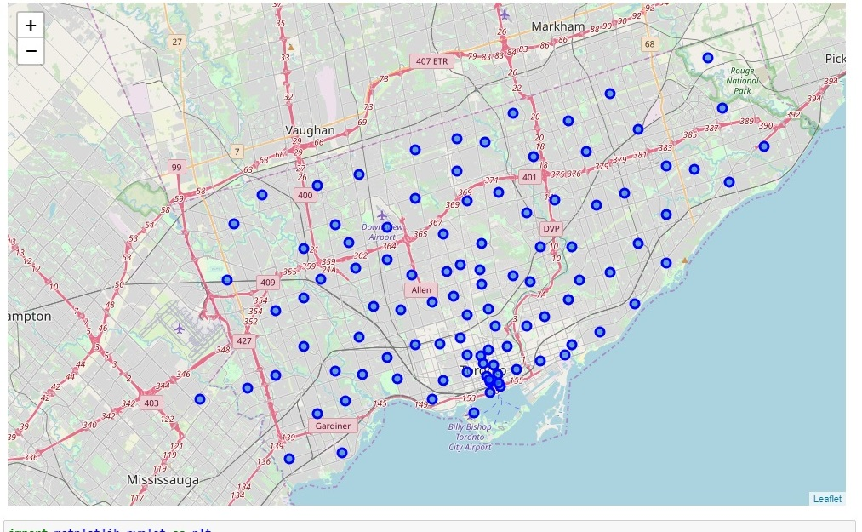
Toronto
Provincial capital of Ontario
Most populous city in Canada with 2,731,571 residents
Fastest growing city in Canada
International center of business, finance, arts, culture
Recognized as one of the most multicultural and cosmopolitan cities in the world
Highly diversified economy
Median economic family income - $82,859

Slide 4
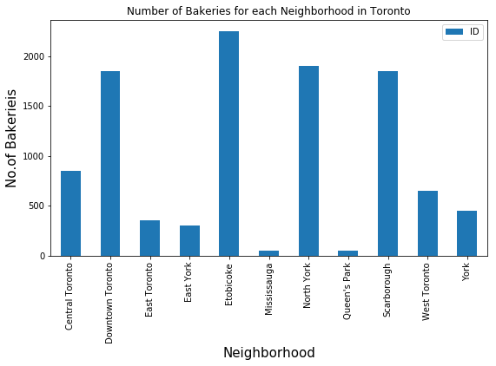
While there are over ten thousand (10,550) bakeries across Toronto, cluster and analysis results show that bakeries (and other dessert-type venues such as Chocolate Shops, Dessert Shops, Donut Shops and Ice Cream Shops) are among the top 10 most common venues in the Downtown Toronto area.
Out of the 18 neighborhoods in Downtown Toronto, bakeries (and similar venues, i.e. Ice Cream Shop, Bubble Tea Shop and Creperie) were among the top 5 most frequented venues in the following areas: Berczy Park, Cabbagetown/St. James Town, Central Bay Street, Harbourfront/Regent Park, Harbord/University of Toronto, The Esplanade.
Borough | Neighborhood | Latitude | Longitude
Downtown Toronto | Harbourfront, Regent Park | 43.6542 | -79.3606
Downtown Toronto | Harbord, University of Toronto | 43.6619 | -79.3952
Downtown Toronto | St. James Town | 43.6514 | -79.3754
Downtown Toronto | Berczy Park | 43.6447 | -79.3733
Downtown Toronto | Central Bay Street | 43.6579 | -79.3873
Downtown Toronto | Stn A PO Boxes 25 The Esplanade | 43.6437 | -79.3787

Slide 5
Bakeries (and similar venues, i.e. Ice Cream Shop, Bubble Tea Shop and Creperie) were among the top 5 most frequented venues in the following areas: Berczy Park, Cabbagetown/St. James Town, Central Bay Street, Harbourfront/Regent Park, Harbord/University of Toronto, The Esplanade.
----Berczy Park----
venue freq
0 Coffee Shop 0.10
1 Cocktail Bar 0.06
2 Farmers Market 0.04
3 Steakhouse 0.04
4 Bakery 0.04
----Central Bay Street----
venue freq
0 Coffee Shop 0.14
1 Ice Cream Shop 0.06
2 Café 0.06
3 Bubble Tea Shop 0.04
4 Spa 0.04
-Cabbagetown, St. James Town-
venue freq
0 Café 0.07
1 Coffee Shop 0.07
2 Bakery 0.05
3 Restaurant 0.05
4 Italian Restaurant 0.05

Slide 6
----Harbourfront, Regent Park----
venue freq
0 Coffee Shop 0.16
1 Park 0.06
2 Café 0.06
3 Bakery 0.06
4 Gym / Fitness Center 0.04
----Stn A PO Boxes 25 The Esplanade----
venue freq
0 Café 0.06
1 Cocktail Bar 0.06
2 Coffee Shop 0.06
3 Seafood Restaurant 0.04
4 Creperie 0.04
----Harbord, University of Toronto----
venue freq
0 Café 0.14
1 Bar 0.06
2 Bakery 0.06
3 Bookstore 0.06
4 Restaurant 0.06

Slide 7
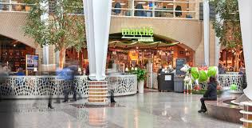
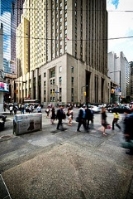
Based on the data, bakeries seem to do well in all of the six areas listed above. Because neither The Esplanade nor Central Bay Street areas offer a bakery, per se but similar dessert-type venues, I would choose one (or both) of those areas to open a bakery as to not be in competition with other bakeries as in other areas. A bakery would complement the other venues located in both Central Bay Street and The Esplanade.
(Central) Bay Street is a major thoroughfare in Downtown Toronto and is the center of Toronto's Financial District. The area attracts many who work in the financial district and those who work in the Discovery District, nearby hospitals and schools (Ryerson University and the University of Toronto). More than 67% (or 10,380) of residents in this area are in the working ages of 25-64.

Slide 8
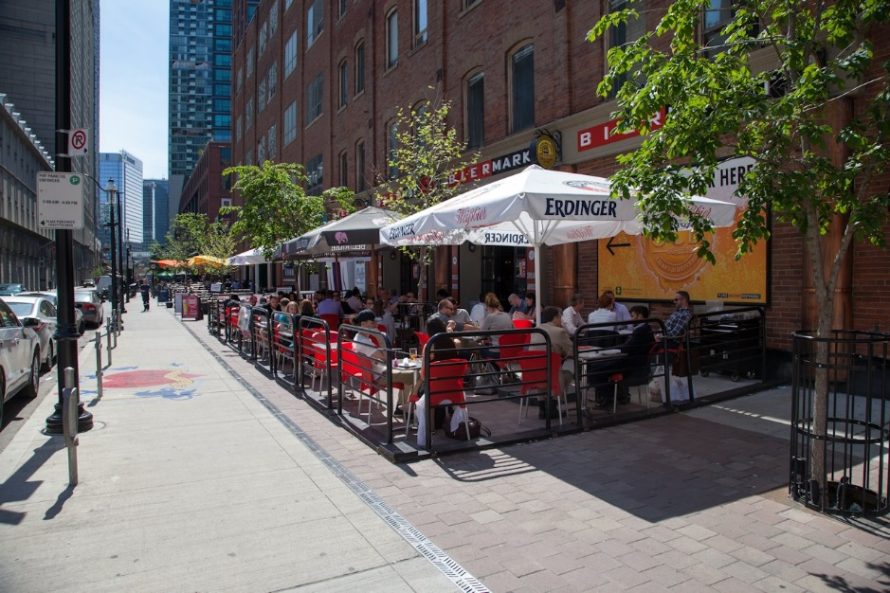
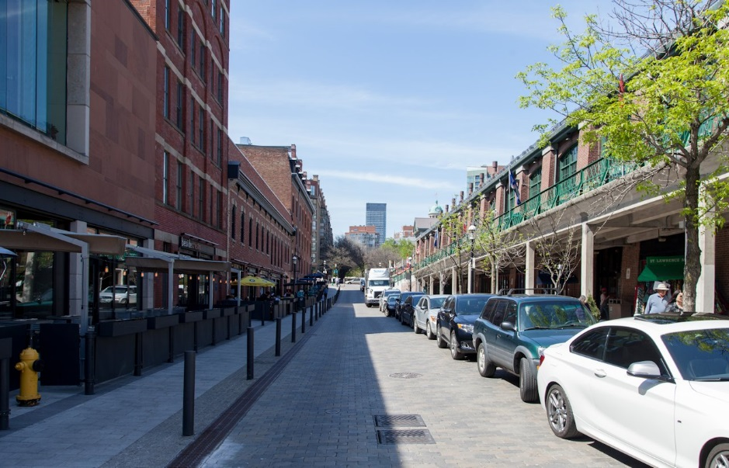
The Esplanade meets the revamped—and award-winning—Market Street just west of the landmark St. Lawrence Market. Widely considered a prime example of successful heritage restoration, Market Street's renewed frontages have recently been populated by new retail, adding vibrancy to the area.
Keeping in mind that the average household income in Toronto was $82,859 (2015) there is room for discretionary spending as is evidenced by the patronage of dessert-type, restaurants and retail venues.

